Slide 1
Font Dialog & Link Label
Prof. Neeraj Bhargava
Kapil Chauhan
Department of Computer Science
School of Engineering & Systems Sciences
MDS University, Ajmer

Slide 2
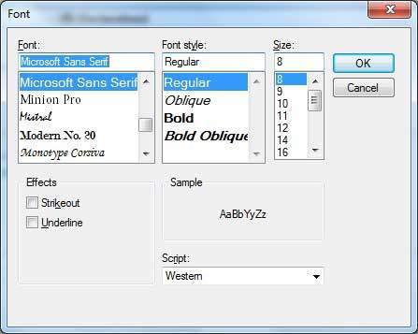
Font Dialog Control
It prompts the user to choose a font from among those installed on the local computer and lets the user select the font, font size, and color. It returns the Font and Color objects.
Following is the Font dialog box −

Slide 3
Properties of the FontDialog Control
AllowSimulations
Gets or sets a value indicating whether the dialog box allows graphics device interface (GDI) font simulations.
AllowVectorFonts
Gets or sets a value indicating whether the dialog box allows vector font selections.
AllowVerticalFonts
Gets or sets a value indicating whether the dialog box displays both vertical and horizontal fonts, or only horizontal fonts.

Slide 4
Color
Gets or sets the selected font color.
FixedPitchOnly
Gets or sets a value indicating whether the dialog box allows only the selection of fixed-pitch fonts.
Font
Gets or sets the selected font.
FontMustExist
Gets or sets a value indicating whether the dialog box specifies an error condition if the user attempts to select a font or style that does not exist.
MaxSize
Gets or sets the maximum point size a user can select.

Slide 5
MinSize
Gets or sets the minimum point size a user can select.
ScriptsOnly
Gets or sets a value indicating whether the dialog box allows selection of fonts for all non-OEM and Symbol character sets, as well as the ANSI character set.
ShowApply
Gets or sets a value indicating whether the dialog box contains an Apply
button.

Slide 6
ShowColor
Gets or sets a value indicating whether the dialog box displays the color choice.
ShowEffects
Gets or sets a value indicating whether the dialog box contains controls that allow the user to specify strikethrough, underline, and text color options.
ShowHelp
Gets or sets a value indicating whether the dialog box displays a Help button.

Slide 7
Methods of the FontDialog Control
Reset
Resets all options to their default values.
RunDialog
When overridden in a derived class, specifies a common dialog box.
ShowDialog
Runs a common dialog box with a default owner.

Slide 8
Linklabel Control in VB.NET
LinkLabel Control is designed such that it provides the functionality of Hyperlink in window application. It is derived from label Control so it also provides all the functionality of Label control.

Slide 9
Properties of Linklabel Control in VB.NET
Property | Purpose
LinkColor | It is used to get or set Fore color of the Hyperlink in its default state.
ActiveLinkColor | It is used to get or set Fore color of the Hyperlink when user clicks it.
DisabledLinkColor | It is used to get or set Fore color of the Hyperlink when LinkLabel is disabled.

Slide 10
Property | Purpose
VisitedLinkColor | It is used to get or set Fore color of the Hyperlink when LinkVisited property of LinkLabel is set to true.
LinkVisited | It is used to specify weather Hyperlink is already visited or not. It has Boolean value. Default value is false.
Text | It is used to get or set text associated with LinkLabel Control.
TextAlign | It is used to get or set alignment of the text associated with LinkLabel Control.
ForeColor | It is used to get or set Fore Color of the text associated with LinkLabel Control.
BackColor | It is used to get or set Background color of the LinkLabel Control.
Enabled | It is used to specify weather LinkLabel control is enabled or not at runtime. It has Boolean value true or false. Default value is true.
Visible | It is used to specify weather LinkLabel control is visible or not at runtime. It has Boolean value true or false. Default value is true.

Slide 11
Methods of Linklabel Control in VB.NET
Method | Purpose
Show | It is used to Show LinkLabel Control at runtime.
Hide | It is used to Hide LinkLabel Control at runtime.
Focus | It is used to set input focus on LinkLabel Control.

Slide 12
Assignment Question
What do you mean by Font Dialog control and explain following
Properties
Method

